Slide 1

Modern App Deep Dive
Xamarin Platform
Kevin Ford
Mobile Practice Lead
Magenic
Level: Intermediate

Slide 2
Development Options
Mobile Enabled Web
Hybrid
True
Native
Near Native
HTML5/JS
Cordova
Xamarin
Java-Android
Objective-C/ Swift /iOS

Slide 3
Native User Interfaces
Native API Access
Native Performance

Slide 4





Application Architecture
HTML 5 UI
iOS UI
Windows Universal
Android UI
JavaScript BL
BL
BL
BL
Service Proxy
Data Portal
Data Portal
Data Portal
Reports
SQL Reporting
REST API
Data Portal
ASP.NET WA
BL
Excel
DAL
PowerPivot
SQL Database
Blobs

Slide 5
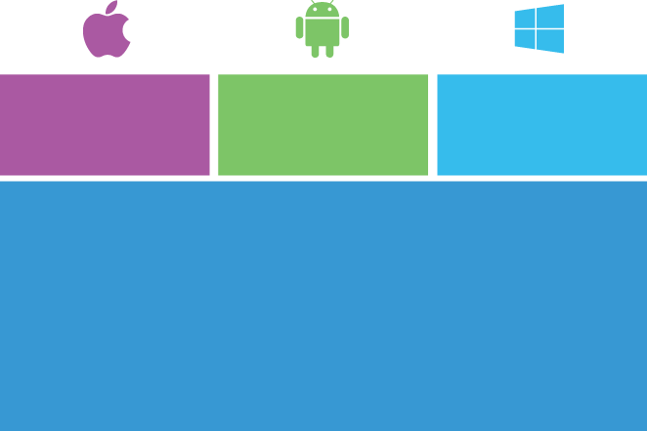

Xamarin Platform vs. Xamarin Forms
iOS C# UI
Android C# UI
Windows C# UI
Xamarin.Forms
Shared App Logic
Shared App Logic
Xamarin.Android / Xamarin.iOS
Xamarin.Forms

Slide 6
Application Architecture
Dealing with Different Sized UIs
Connecting to Azure
Data Binding
Managing the Back stack
Styles
Custom Renderers

Slide 7
Dealing with Different Sized UIs

Slide 8
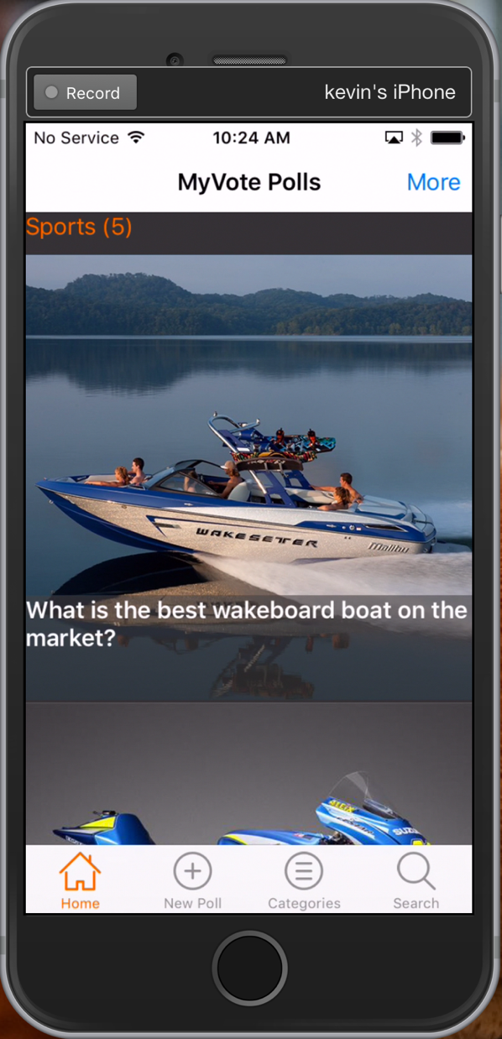
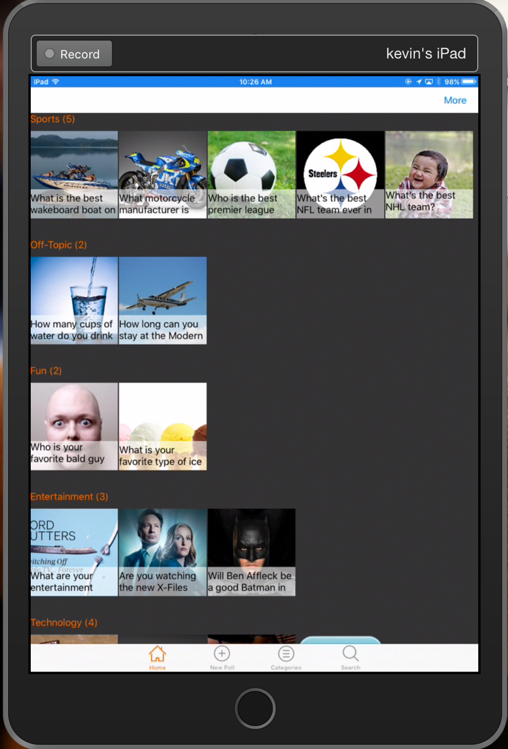
Responsive Vs. Adaptive

Slide 9
Responsive – Xamarin Forms Layouts
<Grid ColumnSpacing="0" RowSpacing="0 HorizontalOptions="FillAndExpand" VerticalOptions="FillAndExpand">
<Grid.RowDefinitions>
<RowDefinition Height="*" />
<RowDefinition Height="Auto" />
<RowDefinition Height="*" />
<RowDefinition Height="Auto" />
<RowDefinition Height="4*" />
</Grid.RowDefinitions>
</Grid>

Slide 10
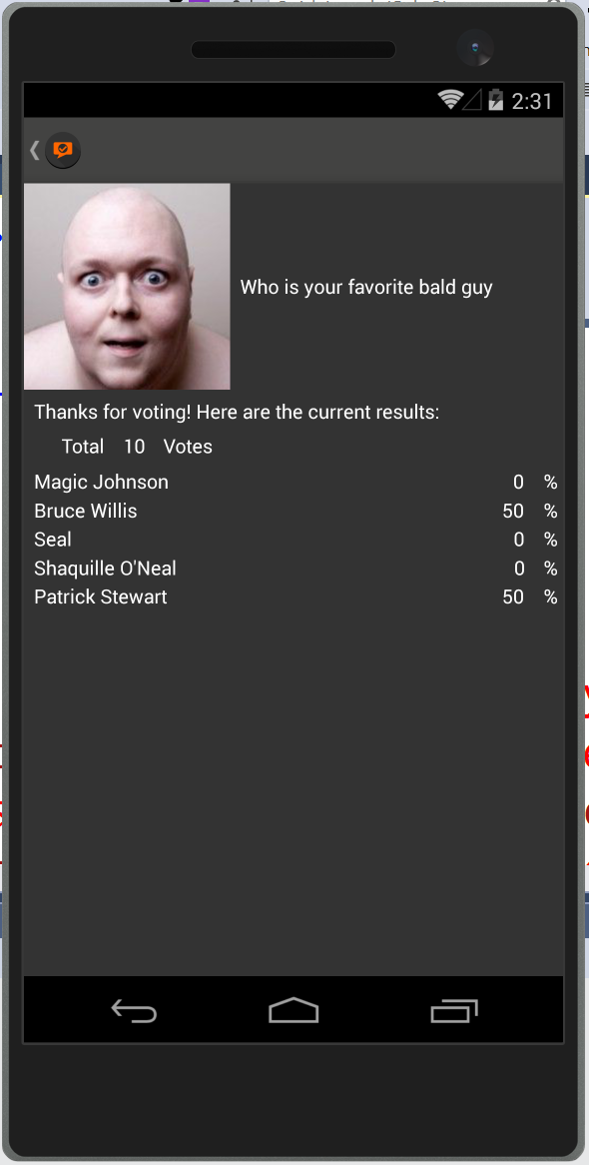
Grid Layout
<Grid.RowDefinitions>
<RowDefinition Height="Auto" />
<RowDefinition Height="Auto" />
<RowDefinition Height="Auto" />
<RowDefinition Height="Auto" />
<RowDefinition Height="*" />
</Grid.RowDefinitions>
</Grid.ColumnDefinitions> <ColumnDefinition Width="Auto" />
<ColumnDefinition Width="*" />
</Grid.ColumnDefinitions>
<Image Grid.Column="0” Grid.Row="0"
VerticalOptions="LayoutOptions.Start"
WidthRequest="150" HeightRequest="150"
Aspect="AspectFill”
Source="{Binding PollResults.PollImageLink}" />
Row = 0
ColumnSpan=2
Row = 1
Row = 2
Row = 3
Row = 4
Column = 0
Column = 1

Slide 11
Responsive – Xamarin Forms Layouts
<RelativeLayout HorizontalOptions="FillAndExpand" VerticalOptions="FillAndExpand">
<Image x:Name="curImage" Aspect="AspectFill" VerticalOptions="FillAndExpand" Source="{Binding ImageLink}"
RelativeLayout.XConstraint="{ConstraintExpression Type=RelativeToParent, Property=Width, Factor=0,
Constant=0}"
RelativeLayout.YConstraint="{ConstraintExpression Type=RelativeToParent, Property=Height, Factor=0,
Constant=0}"
RelativeLayout.WidthConstraint="{ConstraintExpression Type=RelativeToParent, Property=Width, Factor=1,
Constant=0}"
RelativeLayout.HeightConstraint="{ConstraintExpression Type=RelativeToParent, Property=Width, Factor=1,
Constant=0}">
<controls:ExtendedLabel Text="{Binding Question}" HeightRequest="75" LineBreakMode="WordWrap" TextColor="White"
Font="Bold“ BackgroundColor="#98434342"
RelativeLayout.WidthConstraint="{ConstraintExpression Type=RelativeToParent, Property=Width, Factor=1,
Constant=0}"
RelativeLayout.XConstraint="{ConstraintExpression Type=RelativeToParent, Property=Width, Factor=0,
Constant=0}"
RelativeLayout.YConstraint="{ConstraintExpression Type=RelativeToView, ElementName=curImage,
Property=Height, Factor=1, Constant=-75}" />
</RelativeLayout>

Slide 12
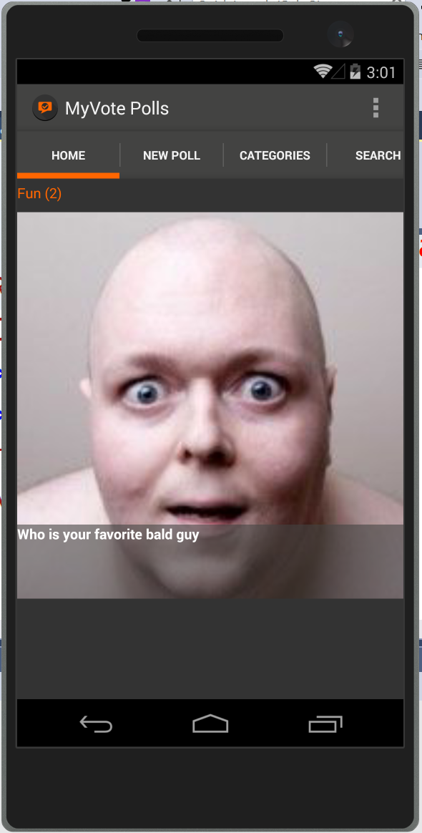
Relative Layout
<RelativeLayout HorizontalOptions="FillAndExpand” VerticalOptions="FillAndExpand">
<Image x:Name="curImage" Aspect="AspectFill"
VerticalOptions="FillAndExpand" Source="{Binding ImageLink}"
RelativeLayout.XConstraint=
"{ConstraintExpression Type=RelativeToParent,
Property=Width, Factor=0, Constant=0}"
RelativeLayout.YConstraint=
"{ConstraintExpression Type=RelativeToParent,
Property=Height, Factor=0, Constant=0}"
RelativeLayout.WidthConstraint=
"{ConstraintExpression Type=RelativeToParent,
Property=Width, Factor=1, Constant=0}"
RelativeLayout.HeightConstraint=
"{ConstraintExpression Type=RelativeToParent,
Property=Width, Factor=1, Constant=0}">
</Image>
<controls:ExtendedLabel Text="{Binding Question}" HeightRequest="75" LineBreakMode="WordWrap" TextColor="White" Font="Bold" BackgroundColor="#98434342"
RelativeLayout.WidthConstraint=
"{ConstraintExpression Type=RelativeToParent,
Property=Width, Factor=1, Constant=0}"
RelativeLayout.XConstraint=
"{ConstraintExpression Type=RelativeToParent,
Property=Width, Factor=0, Constant=0}"
RelativeLayout.YConstraint=
"{ConstraintExpression Type=RelativeToView,
ElementName=curImage, Property=Height, Factor=1,
Constant=-75}" />
</RelativeLayout>
X = Parent width * 0 = 0
Y = Image Height * 1 - 75 = (Image Height – 75)
Y = Parent height * 0 = 0
Height = Parent height * 1 = Parent height
Height = 75
Width = Parent width * 1 = Parent width
Width = Parent width * 1 = Parent width

Slide 13
Responsive – Xamarin Forms Layouts
<StackLayout Orientation="Horizontal"
Spacing="0" VerticalOptions="Start"
HorizontalOptions="FillAndExpand">
<Label Text="{Binding Category}”
TextColor="{StaticResource AppGrayLight}" />
<Label Text="{Binding SearchResults.Count,
StringFormat=' ({0})'}"
TextColor="{StaticResource AppGrayLight}" />
</StackLayout>

Slide 14

StackLayout
<StackLayout Orientation="Vertical" Spacing="20" Padding="0, 0, 0, 0">
<StackLayout Style="{StaticResource
IndividualEntryRegionStyle}">
<controls:ExtendedLabel Text="{Binding
OptionText}”
HorizontalOptions="StartAndExpand"
Style="{StaticResource LabelStyle}" />
<Switch IsToggled="{Binding IsOptionSelected,
Mode=TwoWay}" HorizontalOptions="End" />
</StackLayout>
<BoxView HorizontalOptions="FillAndExpand"
Style="{StaticResource LineStyle}"></BoxView>
</StackLayout>
Start and Expand
End
Padding = 20
Stack Layout
Padding = 20
Spacing = 20
BoxView

Slide 15
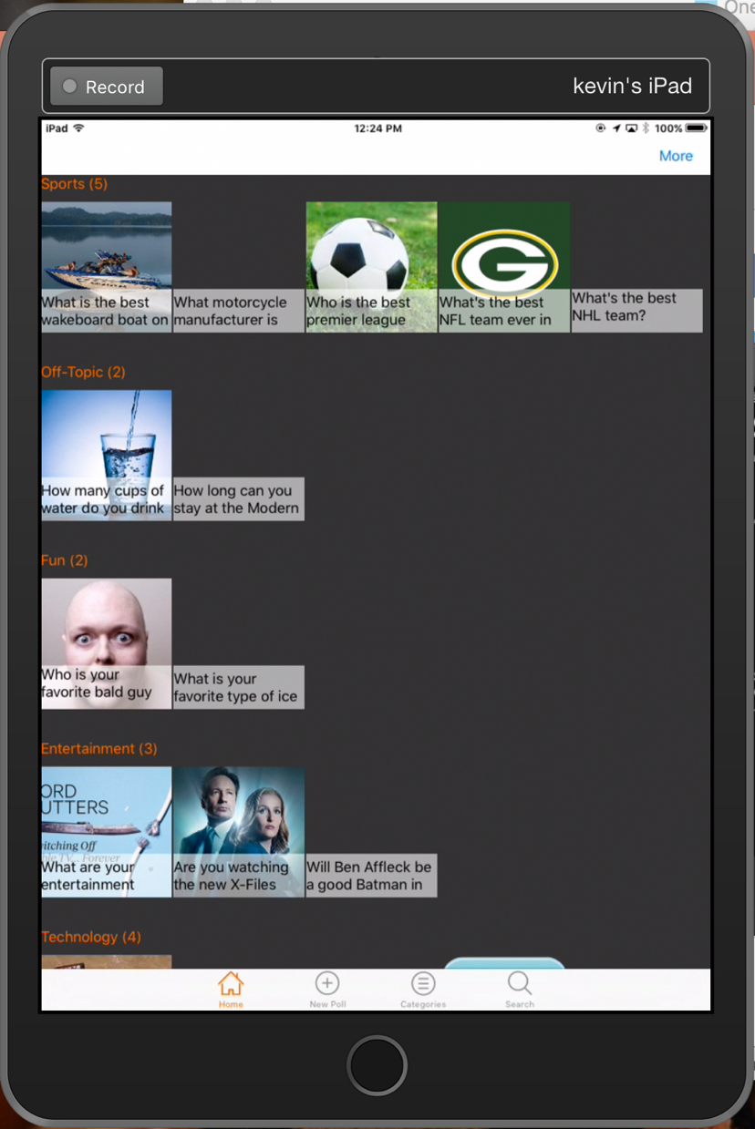
Adaptive
this.Mappings = new Dictionary<Type, Type>
{
{typeof(RegistrationPageViewModel), typeof(RegistrationPage)},
{typeof(ViewPollPageViewModel), typeof(ViewPollPage)},
{typeof(AddPollPageViewModel), typeof(AddPollPage)},
{typeof(PollResultsPageViewModel), typeof(PollResultsPage)}
};
if (Device.Idiom == TargetIdiom.Tablet)
{
this.Mappings.Add(typeof(LandingPageViewModel), typeof(LandingPageTablet));
this.Mappings.Add(typeof(PollsPageViewModel), typeof(PollsPageTablet));
}
else
{
this.Mappings.Add(typeof(LandingPageViewModel), typeof(LandingPagePhone));
this.Mappings.Add(typeof(PollsPageViewModel), typeof(PollsPagePhone));
]}

Slide 16
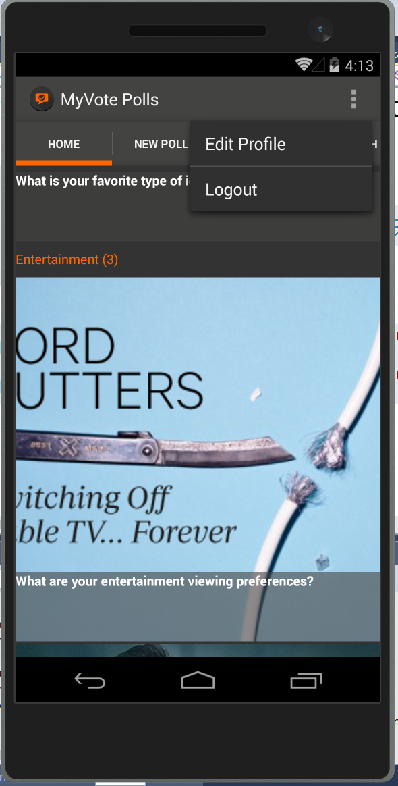
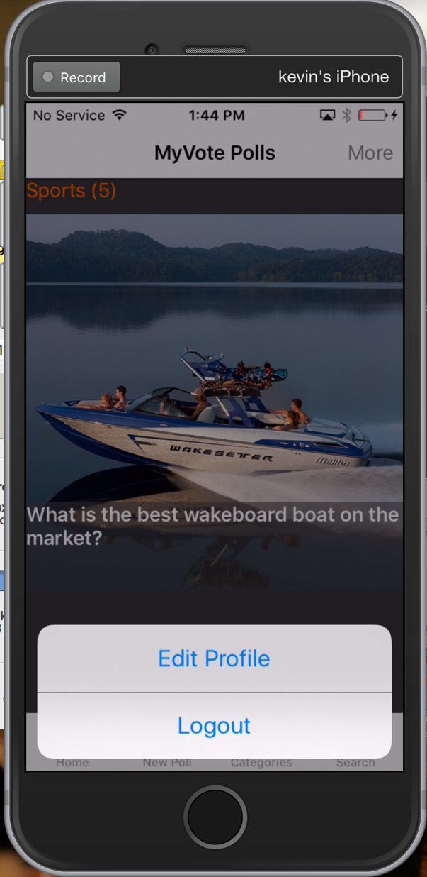
Device.OnPlatform
Device.OnPlatform(
iOS: () => ToolbarItems.Add(new ToolbarItem("More",
"", ActionsClick, ToolbarItemOrder.Primary, 1)),
Android: () =>
{
ToolbarItems.Add(new ToolbarItem("Edit
Profile", "", () => { },
ToolbarItemOrder.Secondary, 1));
ToolbarItems.Add(new ToolbarItem("Logout",
"", () => { }, ToolbarItemOrder.Secondary, 2));
}

Slide 17
Gesture Recognizer
<Image.GestureRecognizers>
<TapGestureRecognizer
Command="{DynamicResource
vmViewPoll}"
CommandParameter="{Binding
Id}" />
</Image.GestureRecognizers>

Slide 18
MVVMCross and Xamarin Forms
MVVMCross 4 offers special Library for Forms
Resolution of what page to load by convention
LoginViewModel tries to load LoginPage.xaml
Android has MvxFormsDroidPagePresenter
iOS uses MvxFormsIosPagePresenter
Expects app to use a NavigationPage
As always, can replace out default implementations

Slide 19
Starting An Android Forms Application
SplashScreen : MvxSplashScreenActivity
Setup : MvxAndroidSetup
App : MvxApplication
FormsActivity : FormsApplicationActivity
FormsApp : MvxFormsApp
LoginPage : ContentPage
LoginViewModel : MvxViewModel

Slide 20
Starting An iOS Forms Application
AppDelegate : MvxApplicationDelegate
Setup : MvxIosSetup
App : MvxApplication
LoginPage : ContentPage
LoginViewModel : BaseViewModel

Slide 21
Demo: Android and iOS MVVM Cross Startup

Slide 22




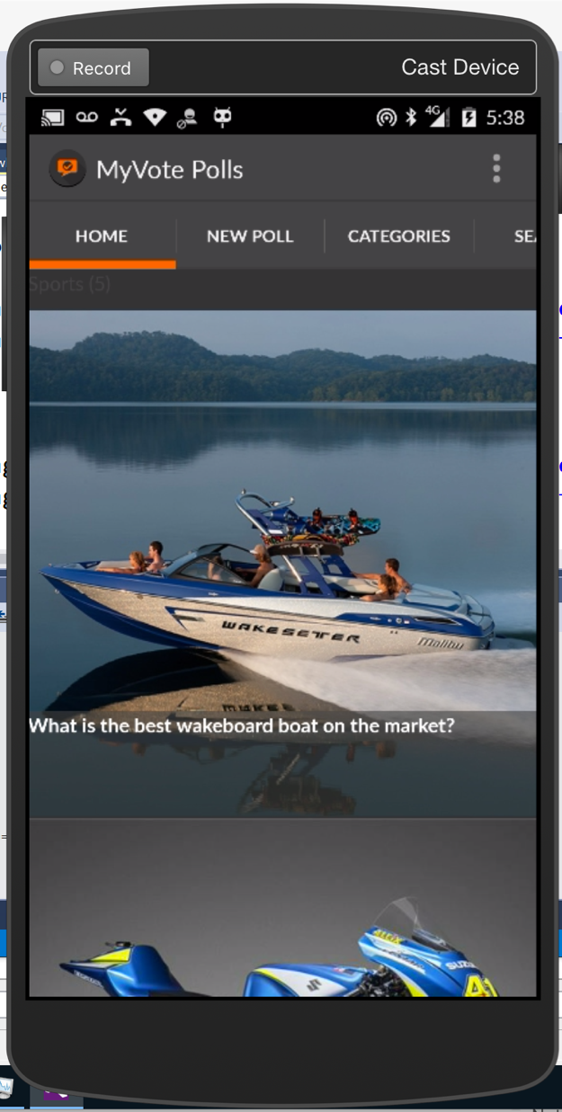
Azure App Usage
Image Ids
Images
Authentication
API (Data portal)

Slide 23
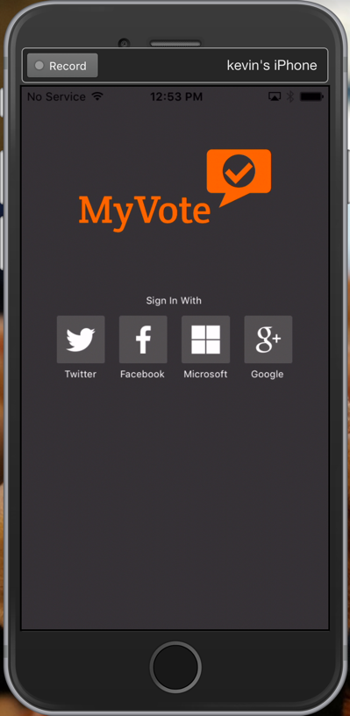
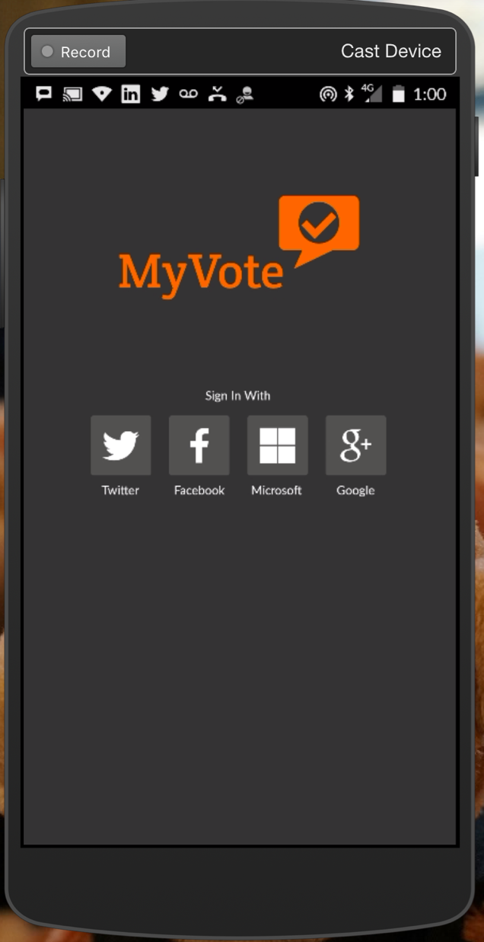
MyVote Authentication

Slide 24
Authentication Thoughts
Can’t control the UI
Only works when online
Does not return information about the user
End up with STS token
Server side components still need to ensure token is valid
Now Rolled into App Services

Slide 25
Client Authentication Code
private readonly MobileServiceClient mobileService = new MobileServiceClient("https://myvote.azure-mobile.net/", "somekey");
public async Task<string> AuthenticateAsync(MobileServiceAuthenticationProvider provider)
{
var user = await this.mobileService.LoginAsync( currentUiContext.CurrentContext, provider);
return user.UserId;
}

Slide 26
Pulling From Azure Storage
Great for BLOB Data
Stored as key value pair where key is URL
URL stored in database as part of poll
Can Control who has access
Private
Blob (public read-only)
Container (public read-only and list)

Slide 27
Demo: Writing Image to Storage Account

Slide 28
Data Binding
Can be done in Xaml and code
Has some, but not all features in UWP Xaml
Missing RelativeSource in particular
By default bind to object set in code behind’s BindingSource property
Use INotifyPropertyChanged to handle keeping views up to date
Binding direction can be
One way
One way to source
Two way

Slide 29
Binding Attributes
Mode
Path
Source
StringFormat
Converter
ConverterParameter

Slide 30
Binding Syntax
Xaml:
Text="{Binding User.FirstName, Mode=TwoWay}”
Code:
txtName.SetBinding(ExtendedEntry.TextProperty, "User.FirstName", BindingMode.TwoWay);

Slide 31
Value Converters
public sealed class NullableDateConverter : IValueConverter
{
public object Convert(object value, Type targetType, object parameter, CultureInfo culture)
{
var dateTime = (DateTime?)value;
return dateTime.HasValue ? dateTime.Value : DateTime.Today.Date;
}
public object ConvertBack(object value, Type targetType, object parameter, CultureInfo culture)
{
var dateTime = (DateTime)value;
return dateTime.Date == DateTime.Today.Date ? null : (DateTime?)dateTime;
}
}

Slide 32
Demo: Data Binding with Xamarin Forms

Slide 33
Dealing with the Back Stack

Slide 34
Xamarin Forms Navigation
Back stack abstracted- NavigationPage
Must always have at least one page in the stack
New pages pushed, popped to go back
PushAsync
PopAsync
PopToRootAsync
Some phones have hardware back button, some do not

Slide 35
Default ViewModel Navigation
Login ViewModel
Registration ViewModel
Landing ViewModel
Registration ViewModel
Landing ViewModel

Slide 36
Enter the Presentation Hint
Login Page
Registration Page
Landing Page
Registration Page
Landing Page

Slide 37
Demo: Dealing with the Navigation Stack

Slide 38
Resources & Styles
Resource Dictionary
Static Resources
Dynamic Resources
Implicit Styles
Style Inheritance
Allows centralized maintenance of app appearance
Resource Types

Slide 39
Resource Dictionary
<ContentPage>
<ContentPage.Resources>
<ResourceDictionary>
<Thickness x:Key="list">10,10,10,10</Thickness>
</ResourceDictionary>
</ContentPage.Resources>
</ContentPage>

Slide 40
Static Resources
Set once and never changed
<ContentPage>
<ContentPage.Resources>
<ResourceDictionary>
<Thickness x:Key=”list">10,10,10,10</Thickness>
</ResourceDictionary>
</ContentPage.Resources>
<StackLayout Padding="{StaticResource list}">
</StackLayout>
</ContentPage>

Slide 41
Dynamic Resources
Updates as the value changes
<ResourceDictionary> <Color x:Key="bkgd">Blue</Color>
</ResourceDictionary>
<StackLayout BackgroundColor="{DynamicResource bkgd}">
</StackLayout>
this.Resources["bkgd"] = Color.Black;

Slide 42
Styles
A Style is a collection of setters for a particular type of view
<Style x:Key="OKButtonStyle" TargetType="Button"> <Setter Property="BackgroundColor" Value="#2A84D3" />
<Setter Property="BorderColor" Value="#1C5F9B" />
<Setter Property="BorderRadius" Value="10” />
<Setter Property="BorderWidth" Value="3" />
<Setter Property="TextColor" Value="White" />
</Style>
<Button Text="OK" Style="{StaticResource OKButtonStyle}" />

Slide 43
Intrinsic Styles
Intrinsic styles omit the x:key and apply to all views of the specified type
<ContentPage.Resources>
<ResourceDictionary>
<Style TargetType="Button">
<Setter Property="BackgroundColor" Value="Blue" />
<Setter Property="BorderColor" Value="Navy" />
</Style>
</ResourceDictionary>
</ContentPage.Resources>

Slide 44
Style Inheritance
Styles can inherit from other styles and override their values
<Style x:Key="BaseButtonStyle" TargetType="Button">
<Setter Property="BackgroundColor" Value="Blue" />
<Setter Property="BorderColor" Value="Navy" />
</Style>
<Style x:Key=”OverrideButtonStyle" TargetType="Button" BasedOn="{StaticResource BaseButtonStyle}">
<Setter Property="BackgroundColor" Value="Purple" />
<Setter Property="Rotation" Value="30" />
</Style>

Slide 45
Demo: My Vote Use of Styles

Slide 46
Custom Renderers
Forms View
iOS Renderer
Android Renderer
UWP Renderer

Slide 47
Custom Renderers
Based on views
Extend existing views
Create new views derived from (VisualElement)
Render written per platform
Extend existing renderers
Create new renderers derived from (VisualElementRenderer)
Platform renderers must be registered at namespace level
[assembly: ExportRenderer(typeof(ExtendedEntry), typeof(ExtendedEntryRenderer))]

Slide 48
Generic Views
Generic Views can be created
Renderers resolved by type matching
No way to match a generic registration lines
Registration lines need to include all possible implementations of the generic
[assembly: ExportRenderer(typeof(BackgroundStringExtendedPicker), typeof(BackgroundExtendedPickerRenderer<string>))]
[assembly: ExportRenderer(typeof(BackgroundIntExtendedPicker), typeof(BackgroundExtendedPickerRenderer<int>))]

Slide 49
Demo: Custom Renderers

Slide 50
Thank you!
Kevin Ford
Twitter: @Bowman74
kevinf@magenic.com
http://windingroadway.blogspot.com

